Slide 1
What do you think of when you think of peace?
Abbey Grange C of E Academy

Slide 2
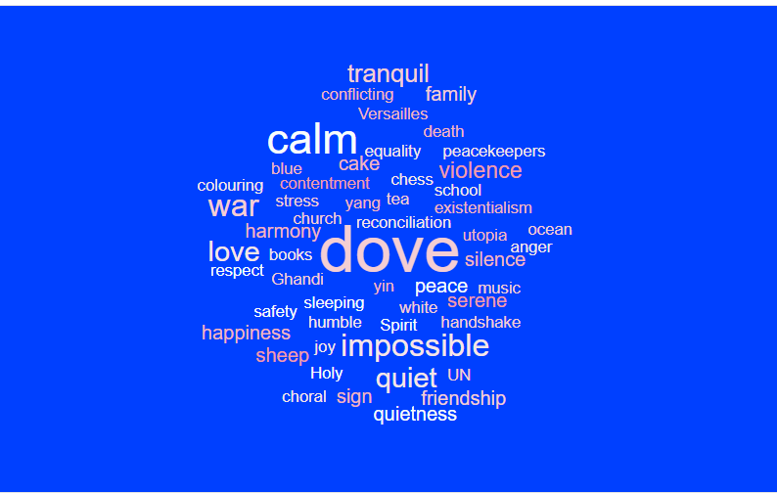

Slide 3
Imagine a world with peace

Slide 4
Which world would you prefer?

Slide 5
The Meaning Of Peace

Slide 6
Prayer for Peace Service
Father in Heaven,
We pray that you will help us to achieve a world of peace by spreading love and friendship. We ask that you will help us to welcome people of different faiths, race and backgrounds into our communities.
Help us to accept people of different religions so that everyone may work peacefully with each other. We pray that everyone will put aside their differences and focus on that which brings us together.
In the Lord’s name we pray,
Amen

